Slide 1
Scripting Languages
Module 11
Windows Scripting

Slide 2
Contents
The Windows command terminal
Windows batch scripts
Windows PowerShell

Slide 3
Learning Objectives
After finishing this module, you should be able to:
Read and write scripts that run on Microsoft Windows platforms
Use the cmd terminal to write and execute commands in Windows
Use Batch and PowerShell to drive automation in Windows environments

Slide 4
The Windows Terminal
Like most operating systems, Microsoft Windows, has a text-based terminal application
It comes with two different shell languages by default:
The MS/DOS based Command (cmd) shell
The modern styled PowerShell shell

Slide 5
CMD batch shell
The command shell (cmd) uses a language based on the commands used in the MS DOS operating system
Scripts containing these commands are referred to as batch scripts (not to be confused with bash)

Slide 6

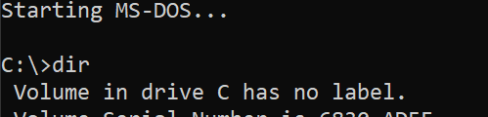
History of the cmd shell

Slide 7
History of the cmd shell
MS DOS is the Microsoft Disk Operating System
It was the primary operating system for most IBM compatible PCs in the 1980s and early 1990s
There was no graphical user interface and all computer tasks were performed by typing cmd commands

Slide 8
Introduction of Windows
In early versions of Windows ( from 1.0 up to Windows Me) the graphical user interface was built on top of the MS-DOS shell
Users could close the graphical environment and use MS-DOS directly instead
Since Windows NT, the cmd shell instead runs on top of the Windows GUI

Slide 9
Simple Batch scripts
Batch scripts support many of the same features that bash scripts support
bash
batch
#!/bin/bash echo "Hello $1"
@echo off echo Hello %1

Slide 10
Simple Batch scripts
Unlike UNIX-Like systems, Windows systems generally do not use shebang/hashbang comments to control scripts
bash
batch
echo "Hello $1"
@echo off echo Hello %1
#!/bin/bash

Slide 11
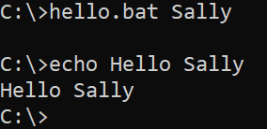

Simple Batch scripts
By default, batch scripts will output each command as it is run
Similar to the bash –x command
Can be disabled using @echo off
bash
batch
echo Hello %1
@echo off echo Hello %1
#!/bin/bash

Slide 12
Batch variables and input
Variables in batch scripts can be set using the set command and referred to using: %%
bash
batch
#!/bin/bash name="Frank" echo $name
@echo off
set name=Frank echo %name%

Slide 13
Batch variables and input
The set command can also be used to read interactive input similar to the read command
bash
#!/bin/bash
read -p "What is your name? " name echo $name
batch
@echo off
set /p name="What is your name? " echo Hello %name%

Slide 14
Control structures
Just like bash, batch scripts support various control structures including if statements, loops and functions
@echo off SET /A x = 20 SET /A y = 30
SET /A z = %x% + %y% if %z%==50 (
echo "The value of variable z is fifty"
) else (
echo "The value of variable z is not fifty"
)
Note: The /A flag sets support for arithmetical variables

Slide 15
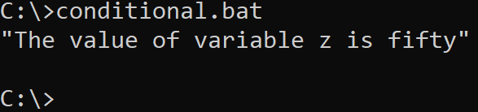
Output

Slide 16
Loops
Batch supports for loops similar to bash
#!/bin/bash
names="Joe Jessie John Alyssa" for name in $names; do
echo "the person's name is $name"
done
bash
@echo off
set names="Joe", "Jessie", "John", "Alyssa" for %%N in (%names%) do (
echo the person's name is %%N
)
batch

Slide 17
Loops
In batch, for loop variables must be single letters:
@echo off
set names="Joe", "Jessie", "John", "Alyssa" for in (%names%) do (
echo the person's name is
)
%%N
%%N

Slide 18
Loops
In batch, C-style for loops are also supported, although the syntax is a little different
@echo off
for /l %%i in (0,1,19) do (
echo "this has been repeated %%i times"
)
starts at 0
@echo off
for /l %%i in (0,1,19) do (
echo "this has been repeated %%i times"
)
i increments by 1
@echo off
for /l %%i in (0,1,19) do (
echo "this has been repeated %%i times"
)
i stops at 19

Slide 19

PowerShell
The previous examples have focussed on standard cmd batch scripts
Since Windows 7, PowerShell 2.0 has been integrated into the operating system as a powerful alternative to cmd

Slide 20
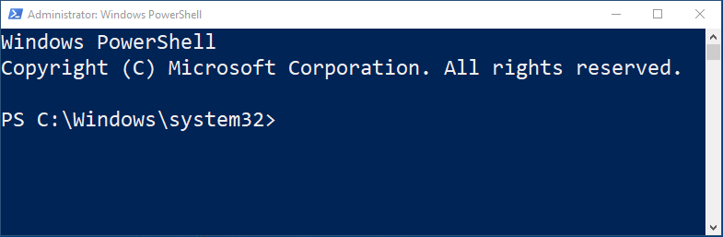
PowerShell
The PowerShell prompt uses the same terminal as the cmd prompt.
However, it is usually coloured blue to help differentiate the two shells.

Slide 21
Bash vs cmd/PowerShell commands
In an attempt to appeal to systems administrators who are used to bash and Unix- Like systems, PowerShell has many aliases for standard bash commands
Bash | Powershell
cd | cd, sl, chdir, Set-Location (commandlet)
ls | ls, dir, Get-ChildItem (commandlet)
cp | Copy-Item (commandlet)
rm | rm, ri, rmdir, rd, del, Remove-Item (commandlet)
touch | New-Item [ItemType] (commandlet)
cat | cat, gc, type
man | Get-Help (commandlet)

Slide 22
PS1 scripts
Powershell scripts are written into .ps1 files
In order to allow these scripts to be executed, you must set the default windows execution policy to allow this:
Set-ExecutionPolicy Unrestricted
For security reasons, the execution policy can also be set to only allow scripts that have been digitally signed by a trusted source to be executed

Slide 23
PS1 scripts
PowerShell scripts use ‘$’ for variables, similar to bash scripts:
$name = Read-Host -Prompt "What is your name? " Write-Output "Hello $name"
The “echo” alias can be used in place of “Write-Output”
$name = Read-Host -Prompt "What is your name? " echo "Hello $name"

Slide 24
Control structures
Just like bash and Batch, PowerShell scripts support various control structures including if statements, loops and functions
PowerShell is also a powerful administration tool as it can access the Windows registry, provide cmdlets for system settings and can access the entire Microsoft .net framework

Slide 25
Loops and conditionals in PowerShell
PowerShell borrows some language structure from C#. Curly braces are used to control scope, similar to other C-like languages
$x = 20
$y = 30
$z = $x + $y
if ($z -eq 50) {
Write-Output "The value of variable z is fifty"
}
else {
Write-Output "The value of variable z is not fifty"
}

Slide 26
Loops and conditionals in PowerShell
Loops are also supported
#!/bin/bash
read -p "please type a number greater than 5 " number while(( $number < 5 )); do
echo "that number is not greater than 5!" read -p "please type a number greater than 5"
number done
echo "thank you!"
Bash
$number = Read-Host -Prompt "please type a number greater than 5" while( $number -lt 5 )
{
Write-Output "that number is not greater than 5!"
$number = Read-Host -Prompt "please type a number greater than 5"
}
Write-Output "thank you!"
PowerShell

Slide 27
Summary
Terms to review and know include:
cmd
Batch
PowerShell
Cmdlet
Windows Scripting

Slide 28
References and Further Reading
https://docs.microsoft.com/en-us/powershell/
https://developer.microsoft.com/en-us/microsoft-edge/tools/vms/
https://www.comparitech.com/net-admin/powershell-cheat-sheet/
https://www.geeksforgeeks.org/writing-windows-batch-script/

